Slide 1
The Synthesis of
O-(4-methyl)-phenyl-N-(9’-acridnyl)-hydroxylamine
By: Shalika Devireddy and Dheevena Bachu
Notes:
D

Slide 2
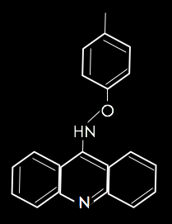
The Compound
A novel-anti tumor drug
DNA Intercalate
Catalytic Inhibitor
9-aminoacridine derivative
Attempts to reduce the side effects of chemotherapy
Notes:
S

Slide 3

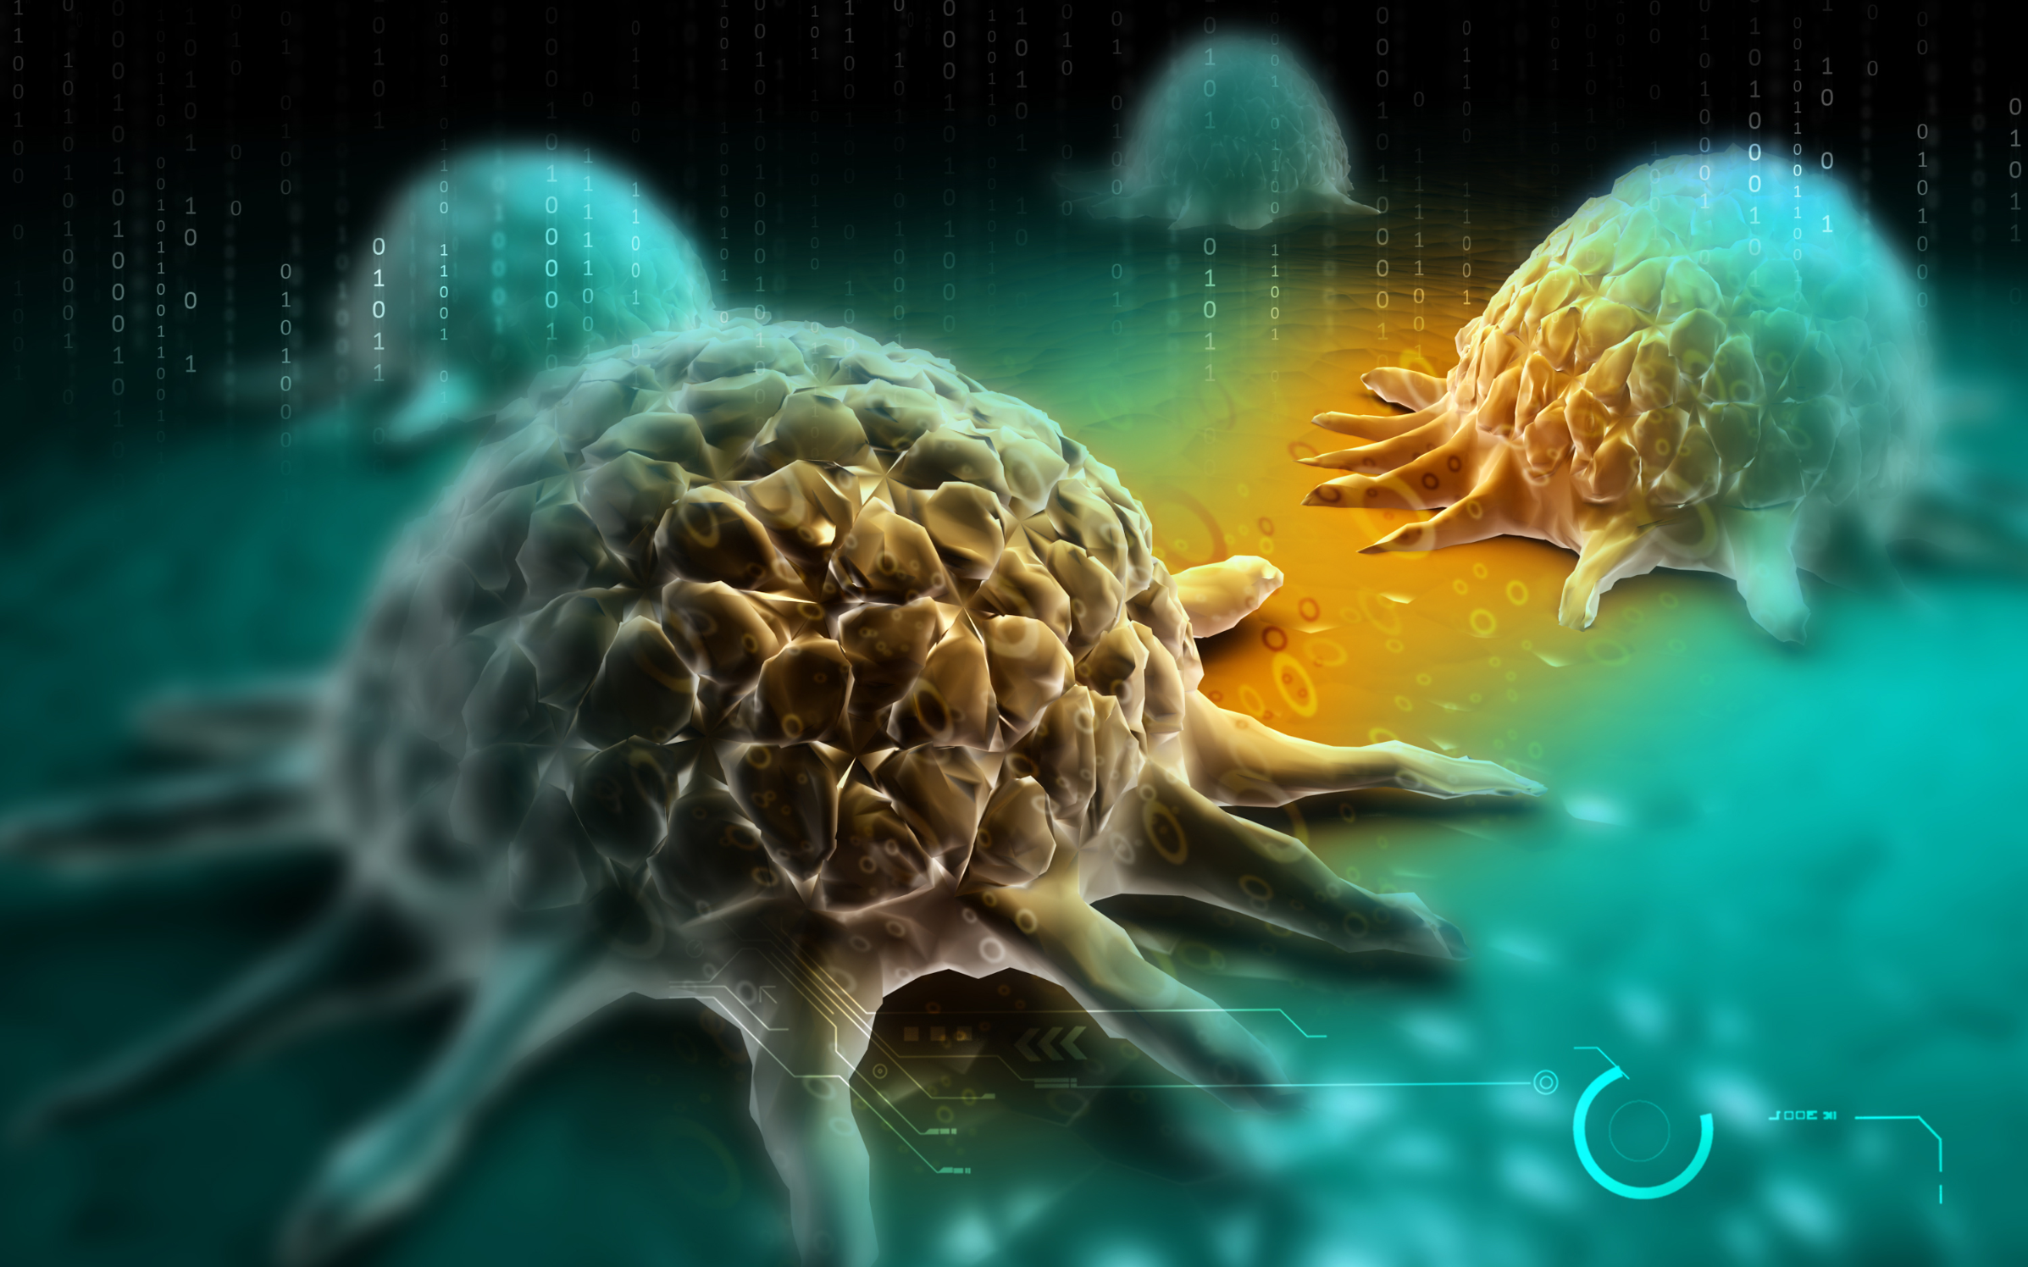
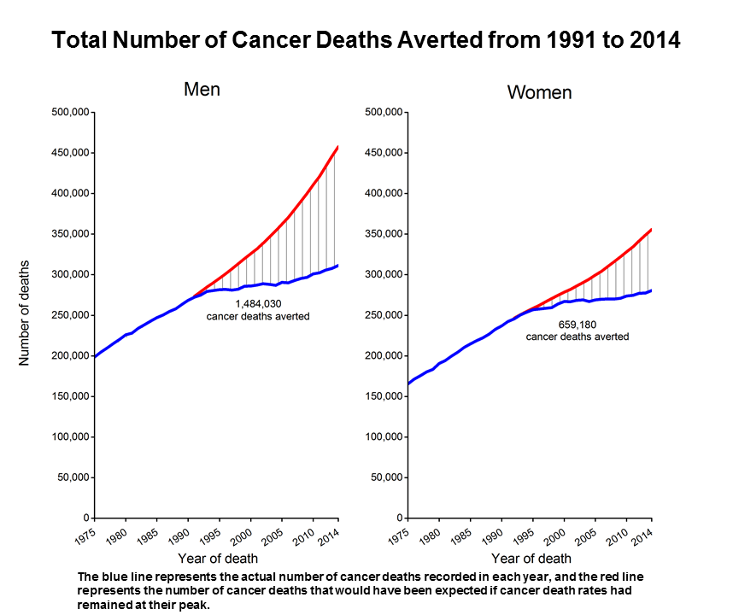
Cancer
Uncontrollable growth of abnormal cells in the body
1,688,780 are estimated to be diagnosed with cancer(2017)
600,920 are estimated to die of cancer(2017)
3 main treatments
Notes:
D Surgery – mainly used to eradicate large tumors
Chemotherapy – an anti-cancer drugs that decreases the rate of repication in cancer cells
Radiation Therapy – uses targeted energy to destroy cancer cells, shrink tumors, etc
Graph – american cancer society
http://www.cancercenter.com/what-is-cancer/?source=BNGPS01&channel=paid+search&invsrc=Non_Branded_Paid_Search_Bing_General_Search&utm_device=c&utm_budget=Corporate&utm_site=BING&utm_campaign=Non+Brand%3ECancer%3EGeneral&utm_adgroup=General%3ECancer%3EExact&utm_term=cancer+facts&utm_matchtype=e&k_clickid=d7f24f07-107b-4925-a082-34e17765b015&k_profid=422&k_kwid=3975209
https://seer.cancer.gov/statfacts/html/all.html
http://www.cancercenter.com/ctca-difference/integrative-cancer-treatment/?source=GGLPS01&channel=paid+search&invsrc=Non_Branded_Paid_Search_Google_General_Search&utm_device=c&utm_budget=Corporate&utm_site=GOOGLE&utm_campaign=Non+Brand%3ETreatments&utm_adgroup=Treatment%3ECancer+Treatment%3EPhrase&utm_term=cancertreatment&utm_matchtype=p&k_clickid=d7f24f07-107b-4925-a082-34e17765b015&k_profid=422&k_kwid=3852255

Slide 4
Background

Slide 5
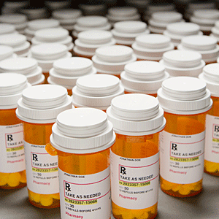
Chemotherapy
Works by interrupting the cell cycle
Two types:
  Cell cycle–specific drugs
  Cell cycle–non-specific drugs
Cell cycle-non-specific drug known as a DNA intercalate
Notes:
S
Most chemotherapy drugs work by interrupting the cell cycle. There are two type of chemotherapy drugs, cell cycle specific drugs and cell cycle non specific drugs. Cell specific drugs means that the drugs only
All cells go through the cell cycle. This is the process by which cells divide to produce more cells. Chemotherapy drugs interrupt the cell cycle and slow down or stop cancer cells’ reproduction. There are two types of chemotherapy drugs. Some drugs specifically affect cancer cells going through one or more phases of the cell cycle and are called cell cycle–specific drugs. Others affect cancer cells in all phases of the cell cycle, regardless of whether they are dividing or resting and this is called cell cycle–non-specific drugs.
Our drug, O-(4-methyl)-phenyl-N-(9’acridnyl)-hydroxylamine, is a cell cycle specific drug. It affects the drug during DNA replication, which means this type of drug is a DNA intercalte.
Read more: http://www.cancer.ca/en/cancer-information/diagnosis-and-treatment/chemotherapy-and-other-drug-therapies/chemotherapy/how-chemotherapy-works/?region=on#ixzz4nKnS5DWv

Slide 6
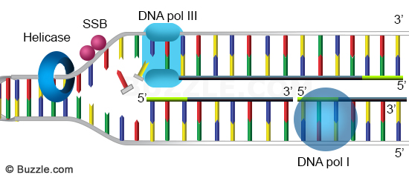
DNA replication
Starts when helicase enters the cell and starts to unzip the DNA
Topoisomerase is an enzyme that uncoils the DNA
After that DNA polymerase enters the cell to create the complement strand of DNA
Notes:
S
DNA intercalates start working when the DNA starts replicating, when the helicase enters the cell to separate the DNA into two strands so DNA polymerase can enter the cell and create complementing strands of DNA for the existing separating strands. While the Helicase is separating the two strands of DNA they are still supercoiled so tension keeps building up and would keep causing it to keep supercoiling. In order to prevent this an enzyme called topoisomerase enters the cells and uncoils the DNA so the helicase can separate the DNA without extreme coiling. These DNA strands are an essential part of mitosis and meiosis or cell replication.
TOPO 1 and 2
DNA Replication
In order to understand how our drug works we must look at it a molecular level. The drug mostly inhibits DNA replication. So what is DNA replication?
DNA replication is the process in which DNA replicates in order to prepare for mitosis or meiosis, also known as cell division. DNA replication starts when an enzyme called helicase enters the cell and binds itself to the DNA. As the helicase travels down the DNA it unzips the strand making it two separate strands, so DNA polymerase can come in behind it and create a complementary strand. While the Helicase is separating the two strands of DNA they are still supercoiled so tension keeps building up and would keep causing it to keep supercoiling as the helicase is unzipping. In order to prevent this another enzyme called topoisomerase unwinds the DNA.

Slide 7
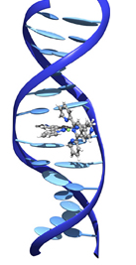
DNA Intercaltors
DNA Intercalator
  substance that inserts itself into the DNA of a cell
  binds to the DNA base pairs
It can act as a:
  Catalytic inhibitor
DNA Intercalate
Notes:
D A substance that inserts itself into the DNA structure of a cell and binds to the DNA, This causes DNA damage. In cancer treatment, DNA intercalating agents may kill cancer cells by damaging their DNA and stopping them from dividing. DNA intercalates act as a topoisomerase poison so when the DNA tries to replicate the drug stops the topoisomerases from doing its job so the DNA tries to split but instead gets even more coiled and is unable to replicate. This in turn induces apoptosis, which is programed cell death. And the cancerous cell dies.

Slide 8
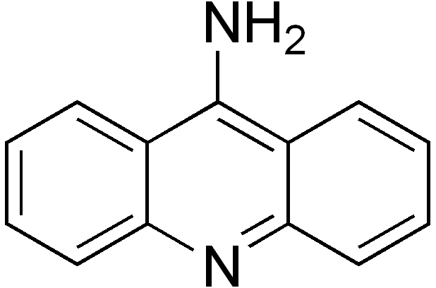
9-aminoacridine
Has proven anti-tumor properties
Proven to be catalytic inhibitors
  Derivative of the drug is tested in rats
Goodell proves that they are catalytic inhibitors by examining the behavior of other derivatives
Notes:
D
Our drug is a 9-aminoacridine drug, which has prooven anti-tumor properties. In research done by Galvez, mice are used to test the effects of the 9-aminoacridine derivative on cancer. From the research it can be concluded that 9-aminoacridine broke down the cancerous cell,
though this experiment was performed on mice, most of the results can similarly be used with human DNA as well because of the vast similarities between our DNA, making O-(4-methyl)-phenyl-N-(9’acridnyl)-hydroxylamine, a catalytic inhibitor of DNA topoisomerase.

Slide 9
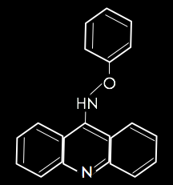
O-phenyl-N-(9’acridnyl)-hydroxylamine
Matthew DeSelm is interested in synthesizing a derivative of 9-amino acridine: O-phenyl-N-(9’acridnyl)-hydroxylamine
Our procedures and methods are derived from his research
Our’s is a derivative with an extra methyl group
Notes:
S

Slide 10
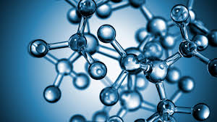
Other DERIVATIVES OF O-phenyl-N-(9’acridnyl)-hydroxylamine
Other Groups
  Includes electron donating/receiving groups
  Receiving groups
    Causes DNA base pairs to bind stronger with the compound
    This derivative takes longer to synthesize
Methyl Groups
  Electron donating groups
  Causes DNA base pairs to bind weaker with the compound
Notes:
D add picture of other group's compound

Slide 11
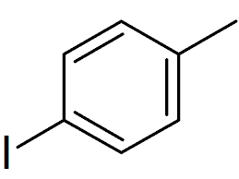
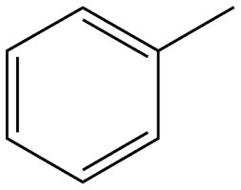
THE METHYL GROUP
An extra carbon bonded to a compound with 3 hydrogens attached
electron donating group
Catalytic inhibitor
Stops DNA Topoisomerase II in separating the double helix during cell replication
Notes:
DHEENU

Slide 12
O-phenyl-N-(9’-acridnyl)-hydroxylamine
O-(4-methyl)-phenyl-N-(9’-acridnyl)-hydroxylamine

Slide 13
Methods
Notes:
4 steps

Slide 14
Step 1: Synthesis of Diaryliodonium Triflate
+
-OTf
+
p-iodotoluene toluene Diaryliodonium Salt
Materials:
  2 mL of Dichloromethane
  0.1g of p-iodotoluene
  0.05 mL of toluene
  120 µL TfOH
  Diethyl Ether
Notes:
Process:
A round bottom flask was placed in the hood and argon gas was inserted into it
All of the below were added to the flask
2 mL of Dichloromethane
0.100297g of p-iodotoluene
0.047913 mL of toluene
120 µL TfOH
Then the mixture was left to stir for 10 minutes

Slide 15
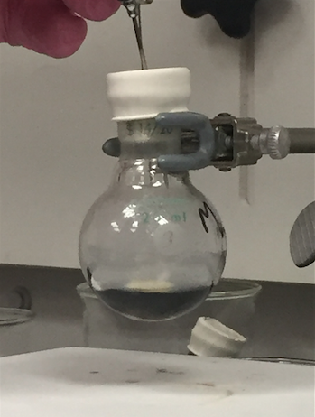
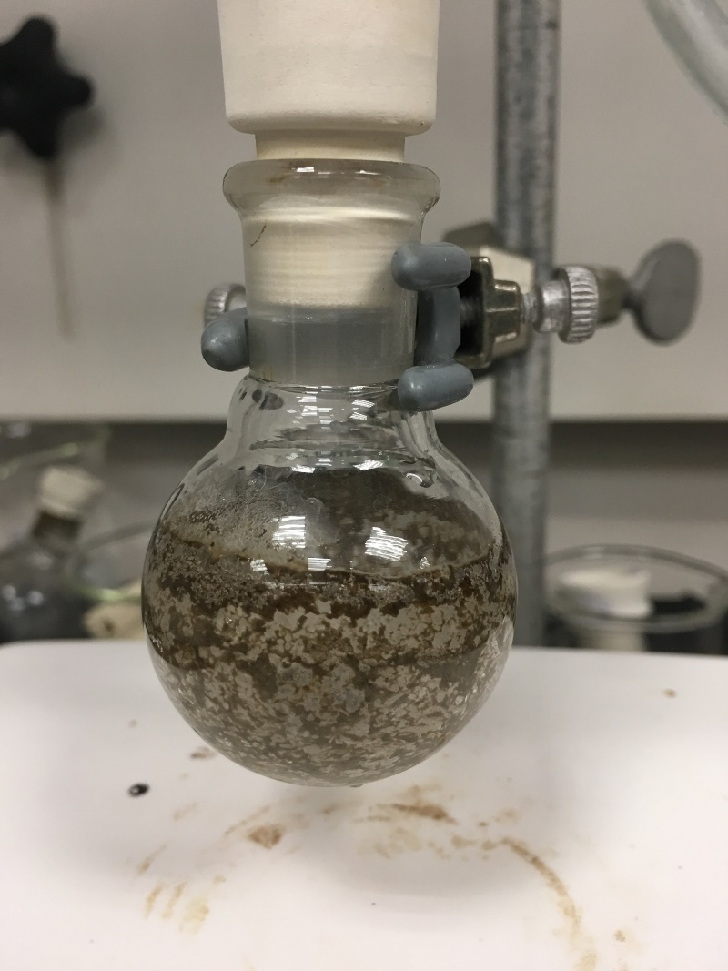
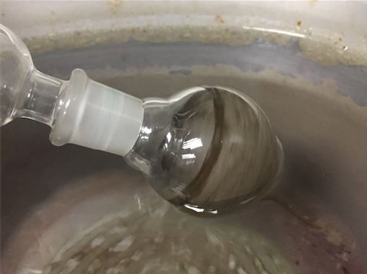
Step 1: Synthesis of
Diaryliodonium Triflate (Continued)
The mixture being rotary evaporated
TfOH being inserted into the flask
The Mixture after being rotary evaporated
Notes:
Next a Rotary Evaporator was used to separate the solvent
Diethyl Ether was then used to dissolve the product in
The mixture was then placed in the fridge for thirty minutes
The Rotary Evaporator was once again used to remove the Diethyl Ether

Slide 16
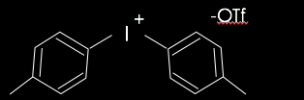
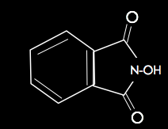
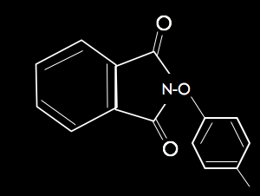
Step 2: Synthesis of N-(4-methyl)-phenyloxyphthalimide
+
Diaryliodonium Salt N-Hydroxythalimide N-(4-methyl)-phenyloxyphthalimide
Materials:
  2 mL of DMF
  62mg of t-BuOK
  82mg of Hydroxyphthalimide
  Ethyl Acetate
  deionized water
  brine
Notes:
Process
In a new round bottom flask, with Argon flowing through it, the below items were placed in it
2ml of DMF
61.7mg of t-BuOK
81.57mg of Hydroxyphthalimide
Diaryliodonium Triflate produced in step one

Slide 17
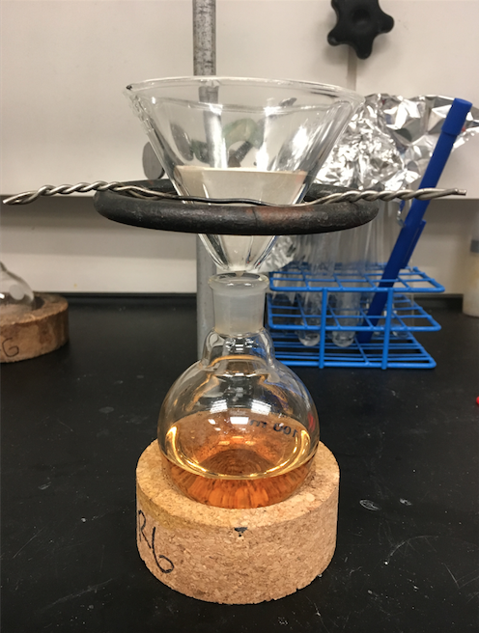
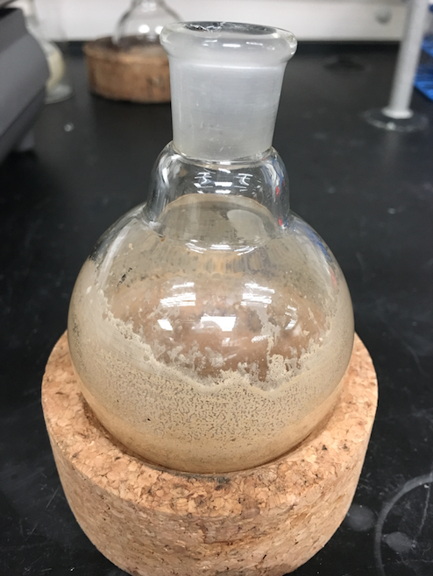
Step 2: Synthesis of N-(4-methyl)-phenyloxyphthalimide (Continued)
The Anhydrous Sulfate being gravity filtered out of the mixture
The syhtesized N-(4-methyl)-phenyloxyphthalimide
Notes:
The solution was then heated to 60 degrees Celsius and left for an hour
A separatory funnel was then used to separate the organic layer from the aqueous layer
Ethyl Acetate, deionized water, and brine aided the separation
The system was then gravity filtered using Anhydrous Sodium Sulfate

Slide 18
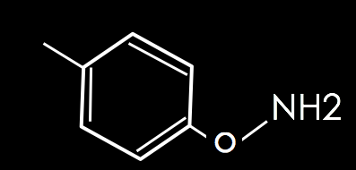
Step 3: Hydrolysis of O-(4-methyl)-phenylhydroxylamine
N-(4-methyl)-phenyloxyphthalimide N-(4-methyl)-phenyloxyphthalimine
Materials:
  1.3mL methonal (MeOH)
  2.7 mL of chloroform (CHCl₃)
  35 mg of potassium carbonate (K₂CO₃)
  35 mg of hydroxylamine hydrochloride (NH₂OH * HCl)
  64 mg of N-(4-methyl)-phenyloxyphthalimide
  20 mL of Et₂O
  80 mL of pentane
Notes:
Inert conditions
Add 4 mL of 1:2 methanol/chloroform (MeOH/CHCl₃) in a stoppered round bottom flask
So 1.33 ml of methonal
2.67 mL of chloroform
And stirred
34.55 mg of potassium carbonate (K₂CO₃)
34.745 mg of hydroxylamine hydrochloride (NH₂OH * HCl)
And stirred then
63.53 mg of N-(4-methyl)-phenyloxyphthalimide added
Stirred for 15 hours at room temp
be filtered through a sintered glass funnel, and washed with Et₂O
will be adsorbed to silica
washed with 100 mL of 20:80 Et₂O:pentane
rotary evaporation to produce a yellow oily substance, O-phenylhydroxylamine.

Slide 19
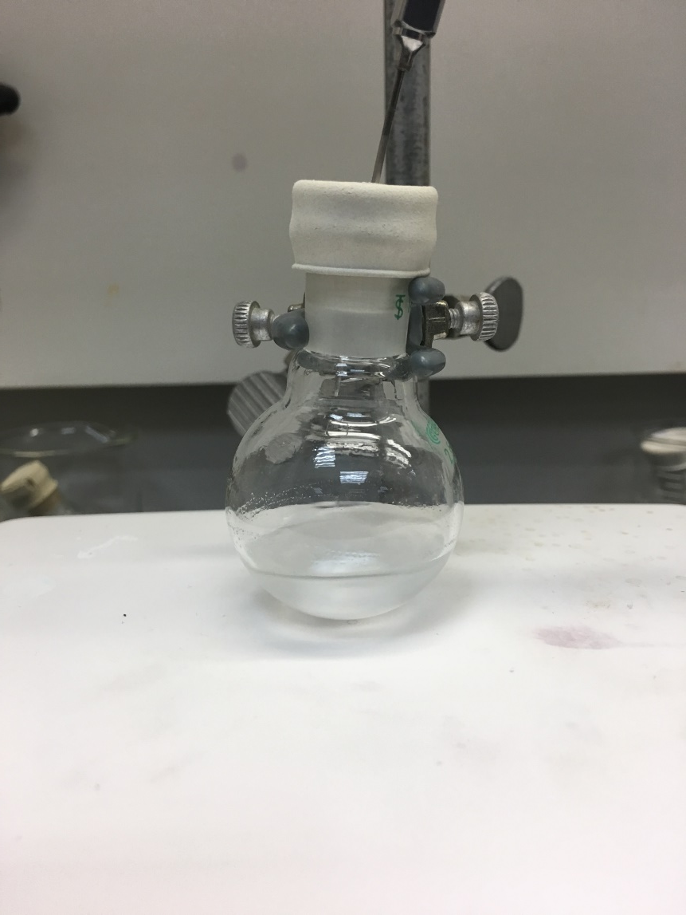
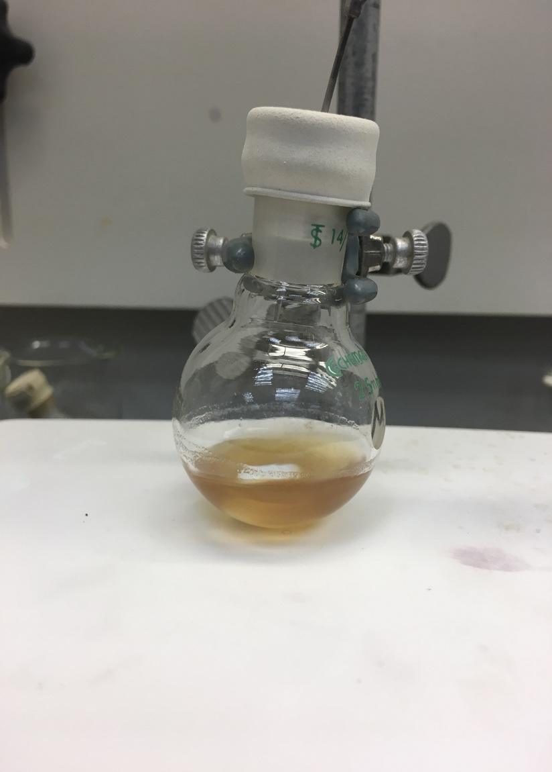
Step 3: Hydrolysis of O-(4-methyl)-phenylhydroxylamine(Continued)
The mixture of methanol,
The mixture after our compound was added

Slide 20
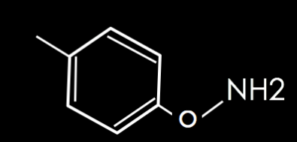
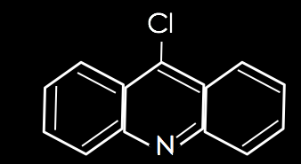
Step 4: Synthesis of O-(4-methyl)-phenyl-N-(9'-acridinyl)-hydroxylamine
+
N-(4-methyl)-phenyloxyphthalimine 9-chloroacridine O-(4-methyl)-phenyl-N-(9'-acridinyl)-hydroxylamine
Materials:
3.3 g phenol
50 mL of CH2Cl2
9-chloroacridine
100 mL of Sodium Hydroxide
Anhydrous Magnesium sulfate
Notes:
Dheenu
In a round bottom flask, 3.3g of PhOH was added
The solution was heated to 88 degrees Celsius, stirred for 6 hours, then cooled to room temperature
In a separatory funnel, the following was added
The solution mentioned above
50ml of CH2Cl2
100ml of Sodium Hydroxide
The system was gravity filtered using Anhydrous Magnesium Sulfate and rotary evaporated
Talk about which layer is organic and which layer is aqueous.

Slide 21
Results

Slide 22
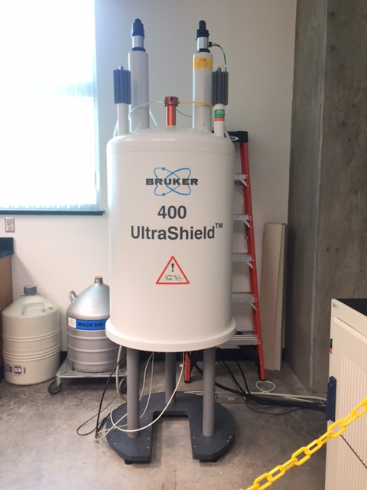
RESULTS
Synthesized to step 2
H-NMR confirmed the product was successfully produced
Percent yield was 80%
Step 3 was attempted with undefined results
A H-NMR machine

Slide 23
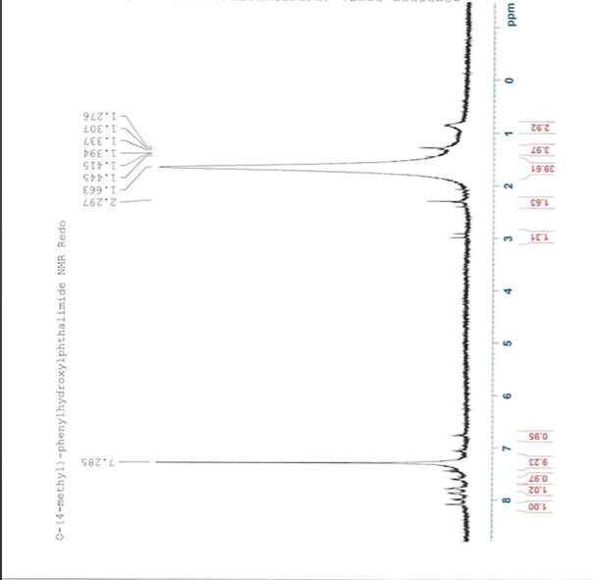
H-NMR of Step 2: Synthesis of N-(4-methyl)-phenyloxyphthalimide trial 1
Notes:
dheenu

Slide 24
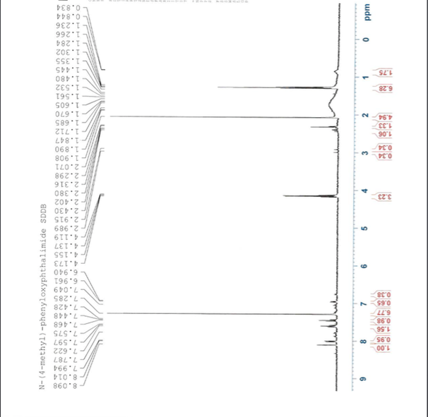
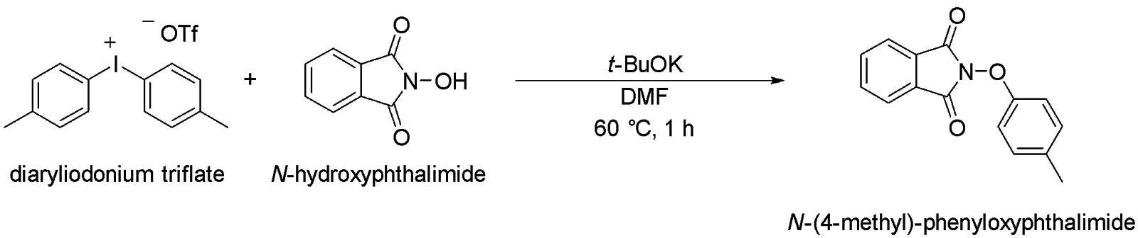
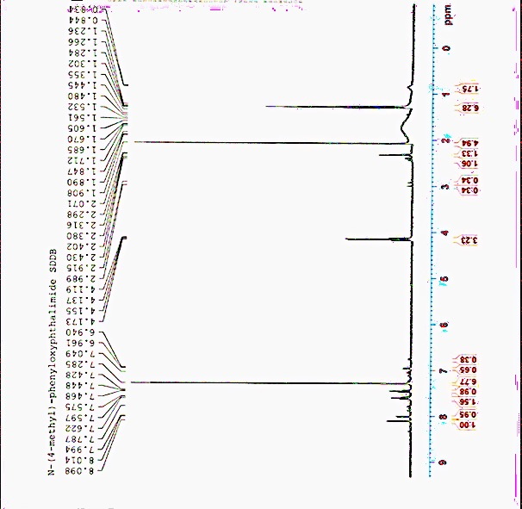
a
A
CDCl3
B
a
A
B
b
b
C
A
B
C
a
b
A
H-NMR of Step 2: Synthesis of N-(4-methyl)-phenyloxyphthalimide trial 2
chloroform
A
A
CHLOROFORM
a
A
CHLOROFORM
a
CHLOROFORM
a
a
B
a
B
a
A
B
A
B
b
A
B
b
B
b
b
b
b
C
C
C
C
A
b
C
A
B
C
a
b
A
B
a
b
a
B
Notes:
dheenu

Slide 25
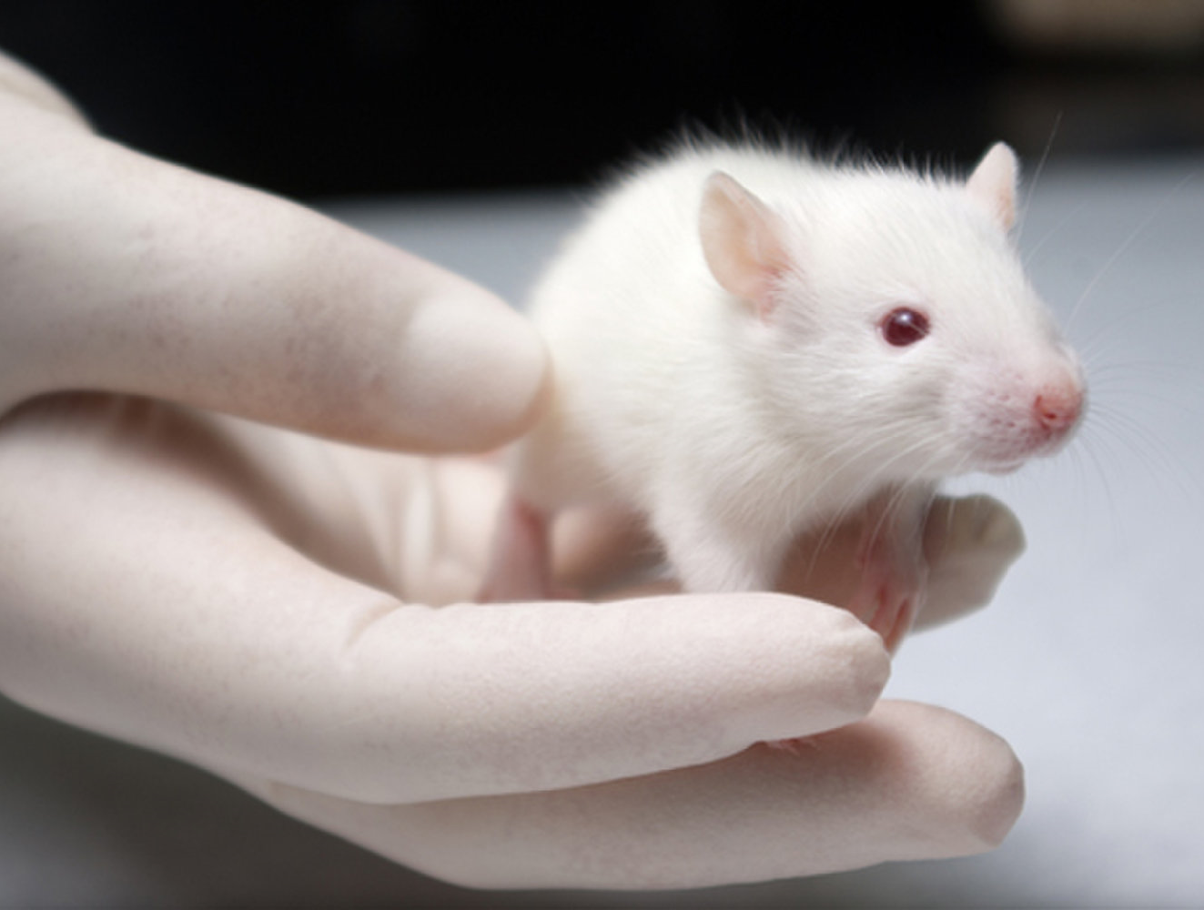
FUTURE STUDIES
If the compound can successfully be synthesized, it will be
  Further researched about other side effects
  Pushed for precise production in larger amounts
  Pushed for higher yields
  Tested on plates of infected cells, next on rodents, small mammals, primates
  Clinical Trials
Notes:
DHEENU

Slide 26
CONCLUSION
Synthesis of step two was more successful than hypothesized due to a higher yield
Synthesis of the compound is possible under inert and specific conditions
Notes:
Since the yields obtained after the completion of step 2 are higher than expected, the synthesis of O-(4-methyl)-phenyl-N-(9’acridnyl)-hydroxylamine was more successful than hypothesized
Although the reaction was incomplete, it is predicted that the synthesis of the compound is possible under inert and specific conditions

Slide 27



ACKNOWLEDGEMENTS
Union Pacific Foundation for funding Shalika Devireddy and Dheevena Bachu's Research
15 Mile Ranch for funding Shalika Devireddy's participation in the Frontiers of Science Institute
The Zimmerle family for funding Dheevena Bachu's participation in the Frontiers of Science Institute
Matthew DeSelm for mentoring and advising us through the research
Saba Wolde for mentoring us
Ben Schottler for aiding us when needed
Scott Newkirk for providing materials during our research project
Frontiers of Science and Lori Ball for offering an opportunity to expand our knowledge and interest in STEM

Slide 28
THANK YOU FOR LISTENING ☺

